Slide 1



PIZZA SALES REPORT - Life’s short, eat more pizza
BY SPOORTHI M
&

Slide 2
CONTENTS
Problem Statement
Tables
SQL Codes
Dashboard

Slide 3
PROBLEM STATEMENT
Retrieve the total number of orders placed.
Calculate the total revenue generated from pizza sales.
Identify the highest-priced pizza.
Identify the most common pizza size ordered.
List the top 5 most ordered pizza types along with their quantities.
Join the relevant tables to find the total quantity of each pizza category ordered.
Determine the distribution of orders by hour of the day.

Slide 4
PROBLEM STATEMENT
Join the relevant tables to find the category-wise distribution of pizzas.
Group the orders by date and calculate the average number of pizzas ordered per day.
Determine the top 3 most ordered pizza types based on revenue.
Calculate the percentage contribution of each pizza type to total revenue.
Analyse the cumulative revenue generated over time.
Determine the top 3 most ordered pizza types based on revenue for each pizza category.

Slide 5

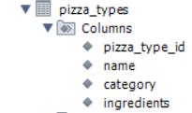
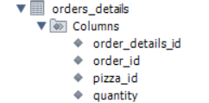
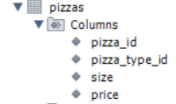
TABLES

Slide 6
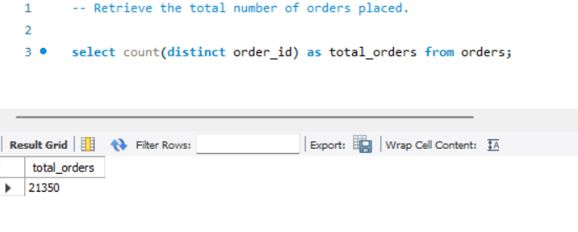
1. Retrieve the total number of orders placed.

Slide 7
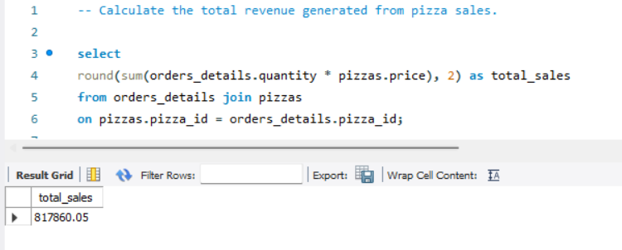
2. Calculate the total revenue generated from pizza sales.

Slide 8
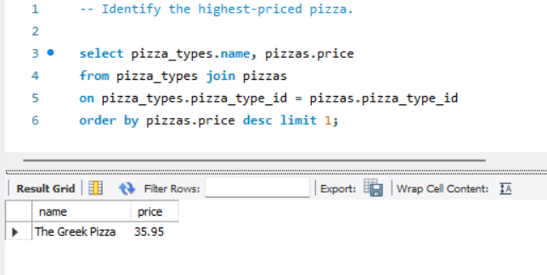
3. Identify the highest-priced pizza.
nthg

Slide 9
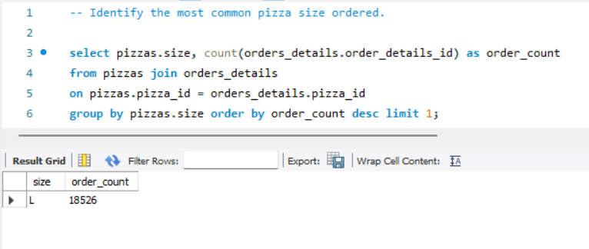
4. Identify the most common pizza size ordered.

Slide 10
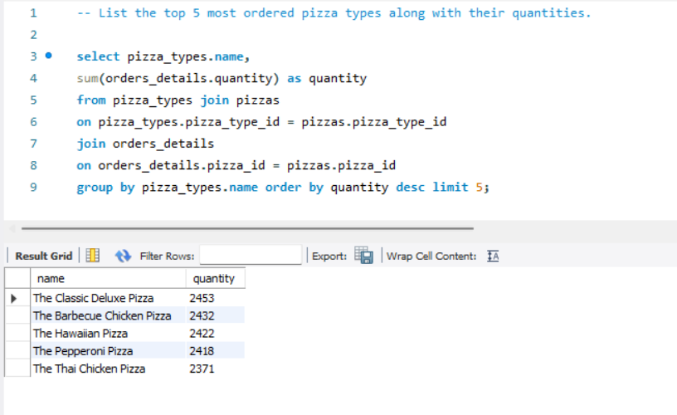
5. List the top 5 most ordered pizza types along with their quantities.

Slide 11
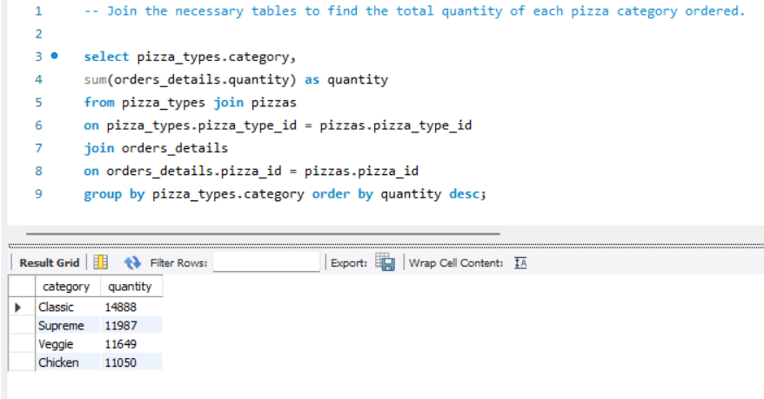
6. Join the relevant tables to find the total quantity of each pizza category ordered.

Slide 12
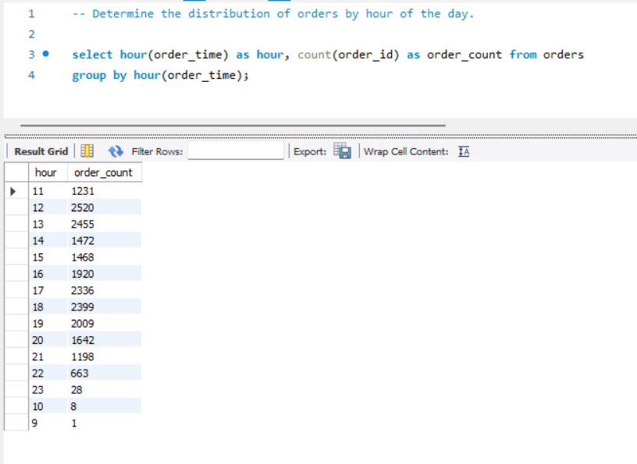
7. Determine the distribution of orders by hour of the day.

Slide 13
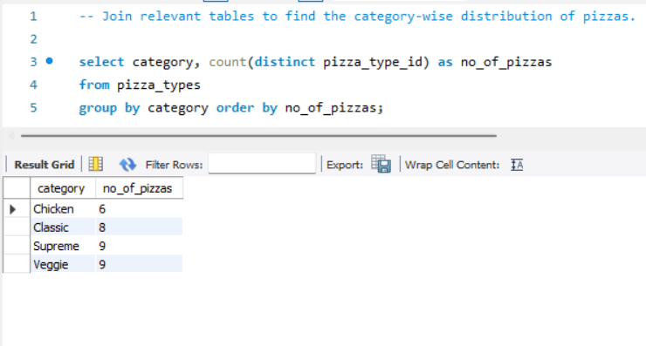
8. Join relevant tables to find the category-wise distribution of pizzas.

Slide 14
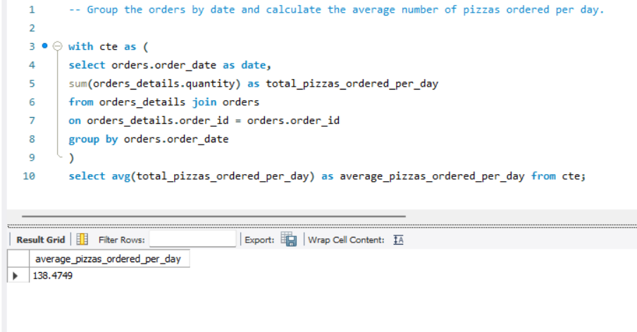
9. Group the orders by date and calculate the average number of pizzas ordered per day.

Slide 15
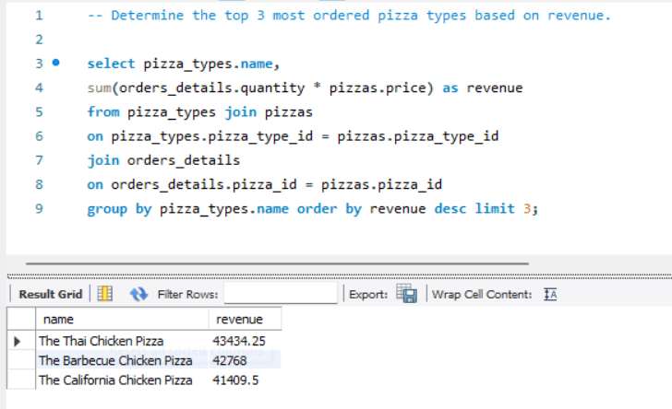
10. Determine the top 3 most ordered pizza types based on the revenue.

Slide 16
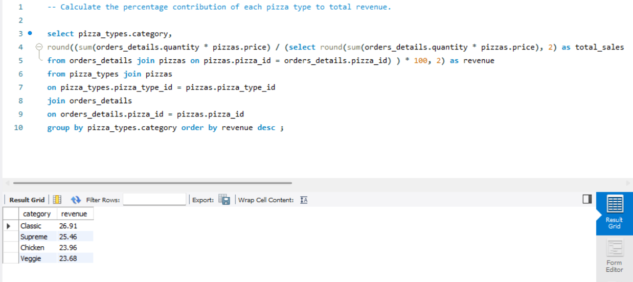
11. Calculate the percentage of each pizza type to total revenue.

Slide 17
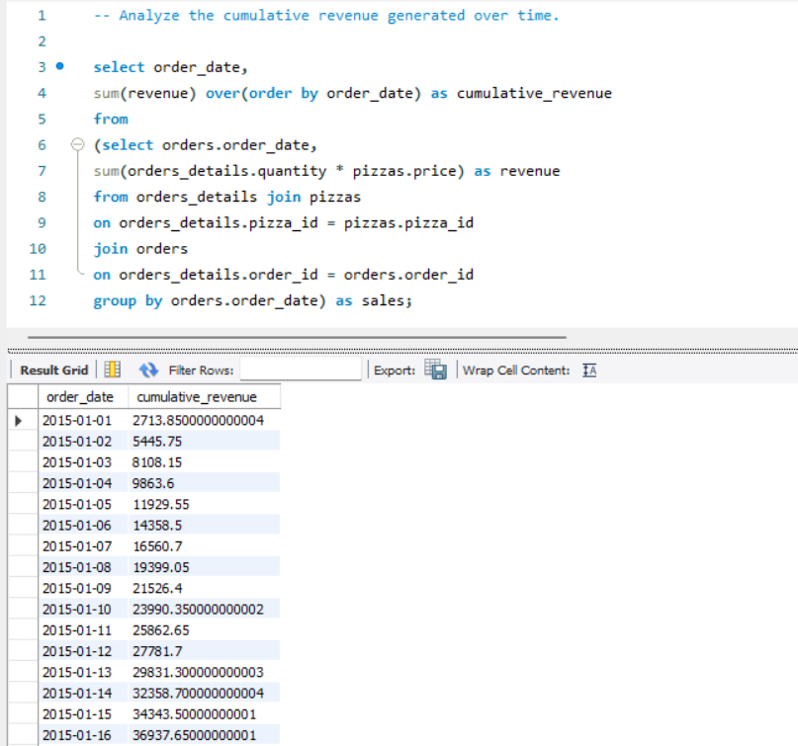
12. Analyze the cumulative revenue generated over time.

Slide 18
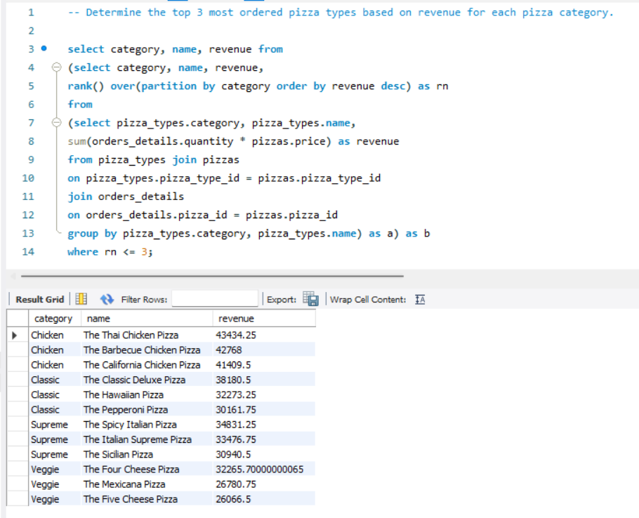
13. Determine the top 3 most ordered pizza types based on revenue for each pizza category.

Slide 19
THANK YOU

